Slide 1

Marketing Your Book with Book Clubs
Member Pro Series for SC Writers’ Association
Kasie Whitener

Slide 2

Who am I?
Kasie Whitener
SCWA’s Events & Education VP
SC Humanities Speaker’s Bureau
MA in English from Winthrop University
Lecturer @ Darla Moore School of Business at U of SC
Radio show host Write On SC
Published author, After December
Serial Book Club Dropout (reject)

Slide 3

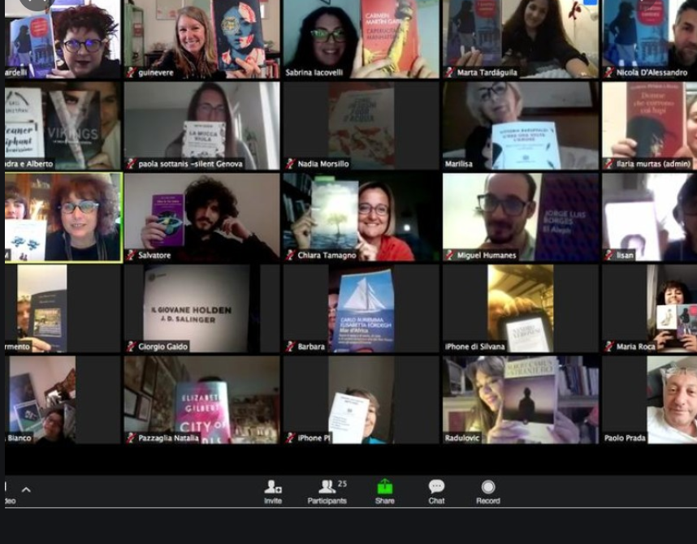


What’s a book club?

Slide 4
Some key things you need to know:
What kind of book club is this?
  What do they want to talk about
  Why are these people in the club?
  How long has the club been around?
  Who is the organizer and how do they add new people?
How serious is this club?
  Do they attend conventions?
  Do they have a selection process?
  Are they organized by a library?
  Do they read by genre?
  Where do they meet and why?

Slide 5
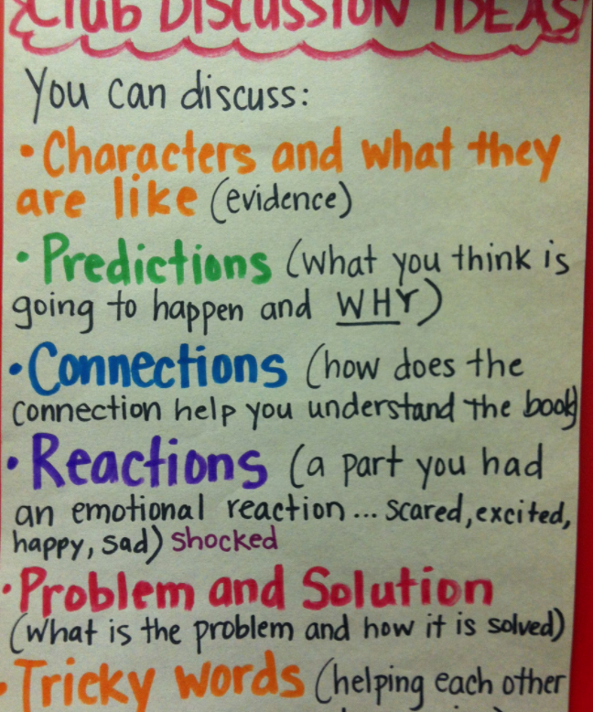
How do you find these clubs?
Google
Libraries
Goodreads
Bloggers
Facebook
Podcasts
Schools
Churches
YMCA & other community organizations

Slide 6
What You Want
Book sales (obvy)
Engagement with readers
Feedback on your work (you can’t do anything about it now, but you’ll use it later)
A chance to see the story in a different way

Slide 7

What You Bring
The Book Club Guide
Themes
Choices
Process stories
Discussion Questions
An open and accepting attitude
Stories adjacent to this one
Recommended reading
Wine (or a hostess gift of some kind)

Slide 8
Find readers. Readers buy books.
and don’t be afraid to go online.

